Slide 1

Maze Runner Robot
19CCE301 Internet of Things

Slide 2
abstract
A maze is given with a single exit and many paths.
The bot finds the shortest path among all the ways and exits.

Slide 3
Algorithm
Takes Maze as input and prints it
Generates the shortest path for the maze using a recursive backtracking algorithm and prints it
Takes the shortest path as the route map and starts its journey
Uses an algorithm to determine the next step until it reaches the end
start
end

Slide 4
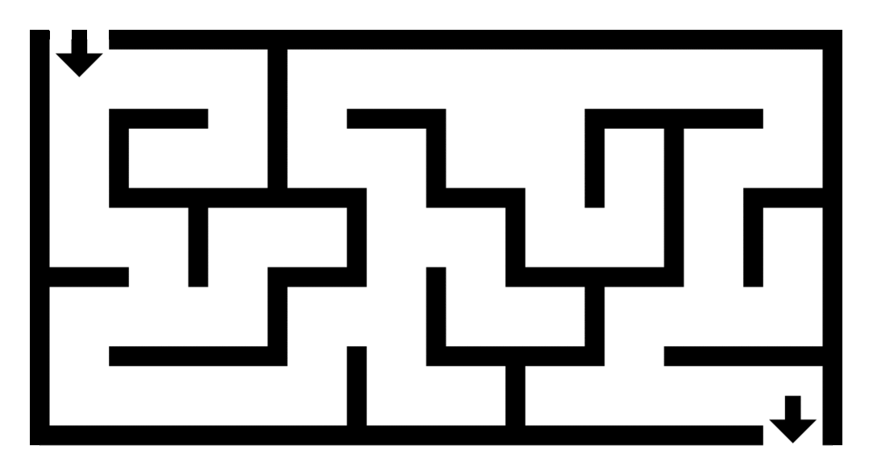
Working: Backtracking Algorithm (DFS)

Slide 5

Working: Direction Navigator
Solution generated acts as path to follow: with two directions into consideration
Initial direction
Final direction
Moves front if both are same
Else rotates (left or right) and moves front according to the relative direction.

Slide 6
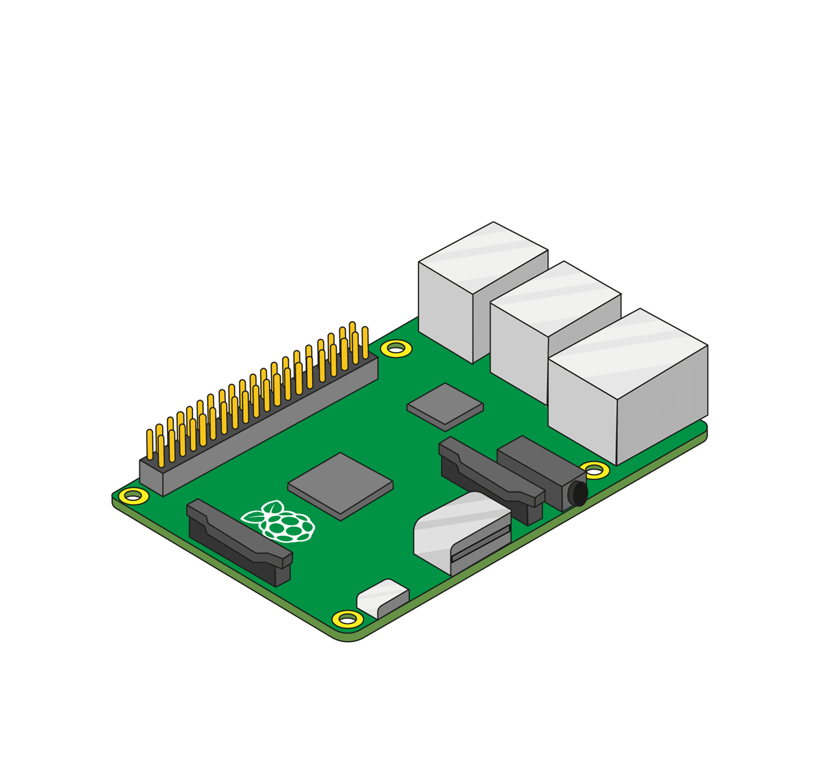
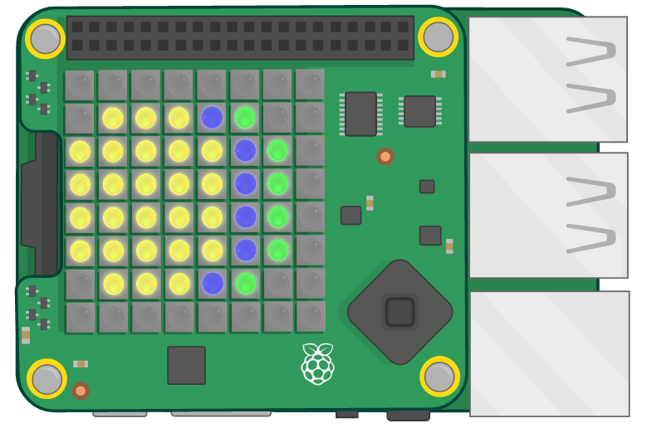
Circuit Diagram

Slide 7
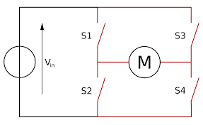
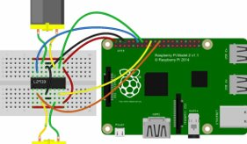
Circuit Diagram

Slide 8
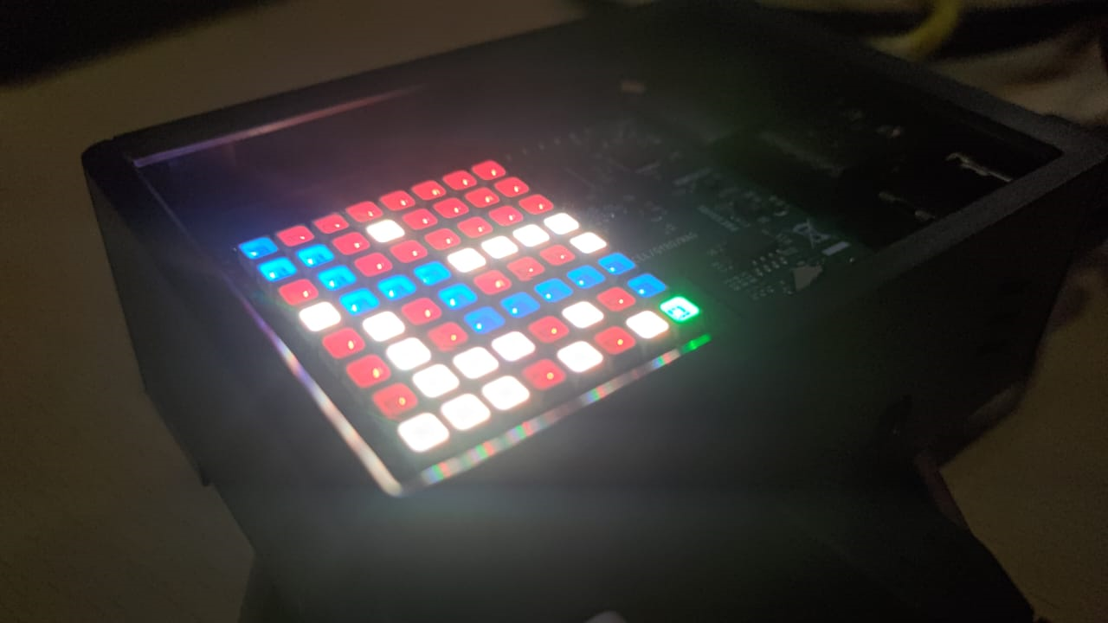
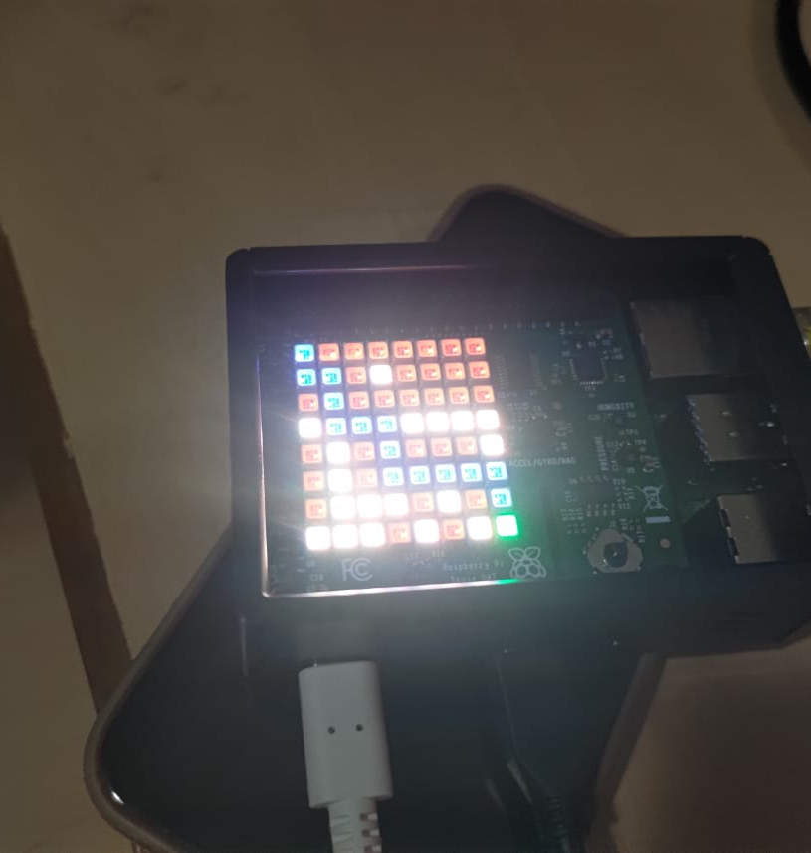
Result

Slide 9
Future Scope:
Creating a automated delivery drone which navigates itself to destination
Additional Proximity sensor would increase the possibility of reduction of error.
Addition of picamera can analyse the road pattern which could help in formulation of automated manuvering system

Slide 10
Thank you

